Slide 1
Physical Education at Orchard School

Slide 2
Physical Education at Orchard School
PURPOSE
To develop competence in
physical fitness
health
participation skills
teamwork
social behaviors
strategies for physical fitness and lifelong health

Slide 3
Physical Education at Orchard School
PROCEDURES/ROUTINES
Students should:
get to class on time every day (5 minutes to dress and line up)
respect teacher/other students/equipment
have their correct gym clothes
follow directions
change out of gym clothes after PE
be positive

Slide 4
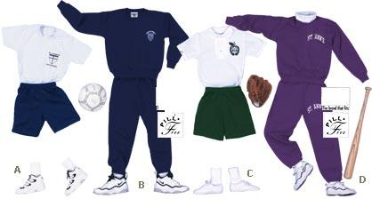
Physical Education at Orchard School
NOTES FOR PARENTS
Gym clothes- students need to wear Orchard gym clothes
T-Shirts-$10
Shorts- $14
Sweat Pants (optional)- $20
Running/Sports shoes
Spare socks/underwear recommended
Students should have a combination lock for their locker
Please wash gym clothes every weekend
Have them shower and use deodorant every day
Let me know if your child has any issues or anxiety about PE
If they need to miss PE in the short term, write a note
Long term, please get a doctor’s certificate

Slide 5
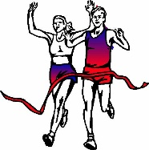
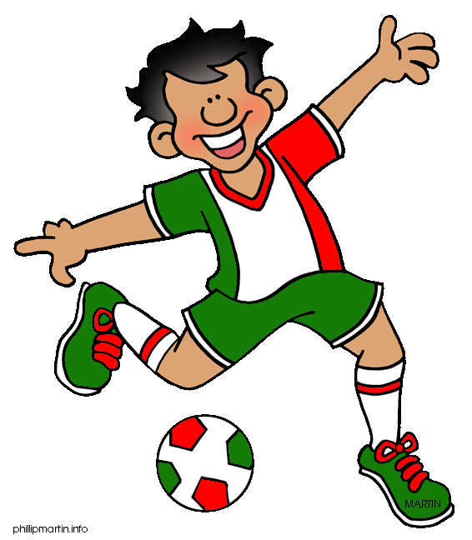
Physical Education at Orchard School
NOTES FOR PARENTS
After school sports:
Cross Country (tryouts Tues Aug 28th/Wed Aug 29th)
Girls Basketball (Oct-Dec)
Boys Basketball (Dec-Jan)
Volleyball (Feb-Apr)
Soccer (Feb-Apr)
Any student wanting to participate in after school sports should fill in an
Athlete participation packet

