Slide 1
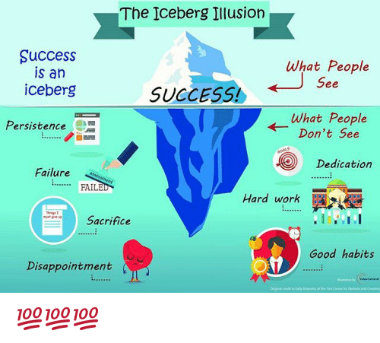
Welcome Back to School Night 6th Grade Orientation August 22, 2019
Orchard Middle School
There is a sign in sheet at each table
Notes:
1

Slide 2
Introductions
Ms. Forrest
Mr. Bushell

Slide 3
Grading Periods
Semester 1 August 14- January 10 | Semester 2 January 13- June 3
Quarter 1 August 14 - October 18th Progress Report | Quarter 3 January 13 - March 24th Progress Report
Quarter 2 October 21st - January 10th Report Card | Quarter 4 March 25th – June 3rd Report Card

Slide 4
Stay Connected
Email Teachers
Check Power School
Sign-Up for Remind App
text message communication
Class codes were sent home.
Ms. Forrest’s website: jforrest.weebly.com

Slide 5
Organization is Key!
Student Planners
Backpack checks
Binder/notebooks
.

Slide 6
6th grade Language Arts
Paths to College and Career
-Reading Closely and Writing to Learn
-Working with Evidence
-Understanding Perspectives
-Reading for Research and Writing an Argument

Slide 7
6th grade Language Arts
Vocabulary Development:
Academic and content specific
Word study (root words, suffixes and prefixes)
Flocabulary- common 6th grade words learned through music and lyrics
Writing
Informational, argumentative, and narrative
Grammar and Mechanics
Listening/Speaking Skills
Critical thinking/Collaboration
Common Core State Standards

Slide 8
6th grade Language Arts
Reading
Novels as a class
Articles/handouts from Mr. Bushell and Ms. Forrest
Reading Logs and Monthly book reviews
Accelerated reading program
Library
school (opening in a few weeks)
class
public

Slide 9
Grading
60% Mastery of Standards (assessments and projects)
*test corrections
*growth mindset
40% -ELA Notebook (Forrest)
-Workbook/assignments (Bushell)
-Flocabulary
-Accelerated Reading (logs and meeting goals)

Slide 10
Homework daily!

Slide 11
Social Studies
Binder with 8 dividers
Interactive Student Notebook
Topics covered this year
Early Humans and the Rise of Civilization
Ancient Egypt and the Near East
Ancient India
Ancient China
Ancient Greece
Ancient Rome

Slide 12
Grading
60% Mastery of Standards (assessments and projects)
*test corrections
*growth mindset
40% Binder Work
-Interactive Student
Notebook (ISN)
-Cornell Notes
-Mapping
-Special assignments

Slide 13
Homework
*a couple of times a week
1.Unfinished classwork
2.Study for tests
3.Projects

Slide 14
Google Classroom

Slide 15
Questions?

